Slide 1


TEAM : S.Ranganathan : S.Krishna Babu
LAKIREDDY BALI REDDY COLLEGE OF ENGINEERING
Enhanced Ambulance Detection System
TARAS INTENSHIP PROJECT PPT

Slide 2
Abstract
Traffic congestion is a severe problem in most of the cities across the world. It is caused by delay in signal, inappropriate timing of traffic signaling etc.
Therefore, for optimizing traffic control, there is an increasing demand in systematic quick automatic system.
using the techniques of Image processing by capturing the images from the camera placed at the traffic signal, the signal timing changes automatically on sensing the traffic density at the junction

Slide 3
Objectives
The objective is to measure the density of traffic using Computer Vision in a Individual Lane.
Detect The Presence of Ambulance in a Single Lane using Computer Vision
Detect The Presence of Ambulance in Multiple Lane using Computer Vision.
Prioritize Lane Based on Distance Between Ambulance and Traffic Light
To implement the Detection of Ambulance from sound using acoustic sensor.

Slide 4
Ambulance Detection using Image Processing
Ambulance is Detected Using Yolo.
Yolo is an algorithm that detects and recognizes various objects in a picture (in real-time). Object detection in YOLOV3 is done as a regression problem and provides the class probabilities of the detected images.
First, We Need to Train Our Model with Lot Images. I Took 446 Images of ambulance to train the Model.
Then, I Use Google Collab to Train The Model. Since Google Collab is Gpu free to run and Train image model.
After 4 hours of training in Google collab, our model able to detect ambulance in video.

Slide 5
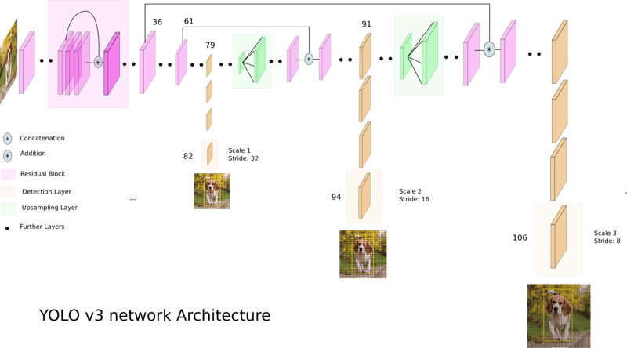
YOLO V3 MODEL WORKING PRINCIPAL

Slide 6
WORKING PRINCIPAL OF THE YOLO-V3
YOLOv3 (You Only Look Once version 3) works by dividing an input image into a grid and then using a convolutional neural network (CNN) called Darknet-53 to predict bounding boxes and class probabilities for objects within each grid cell, essentially performing object detection in a single pass through the network, allowing for real-time detection; its structure consists of a backbone (feature extraction), a neck (feature fusion), and a head (prediction layers) where it outputs bounding boxes and class scores for each detected object, utilizing anchor boxes to guide the prediction of object sizes and locations across multiple scales.

Slide 7
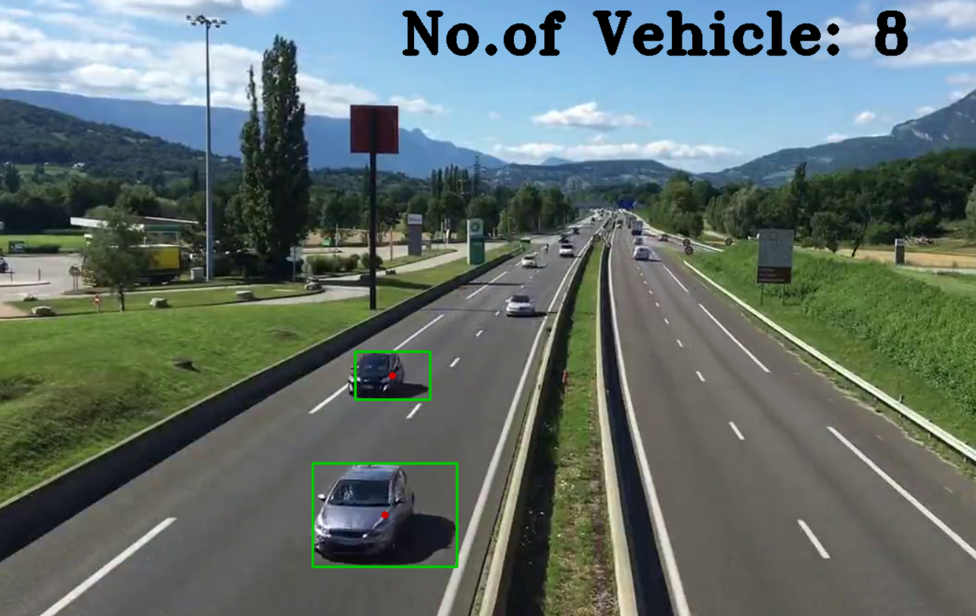
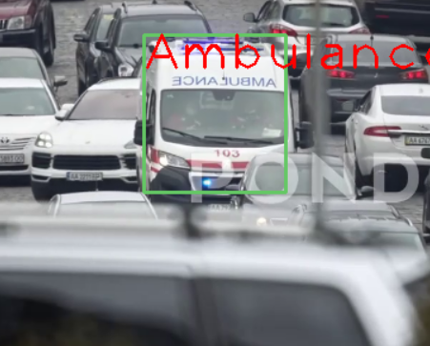
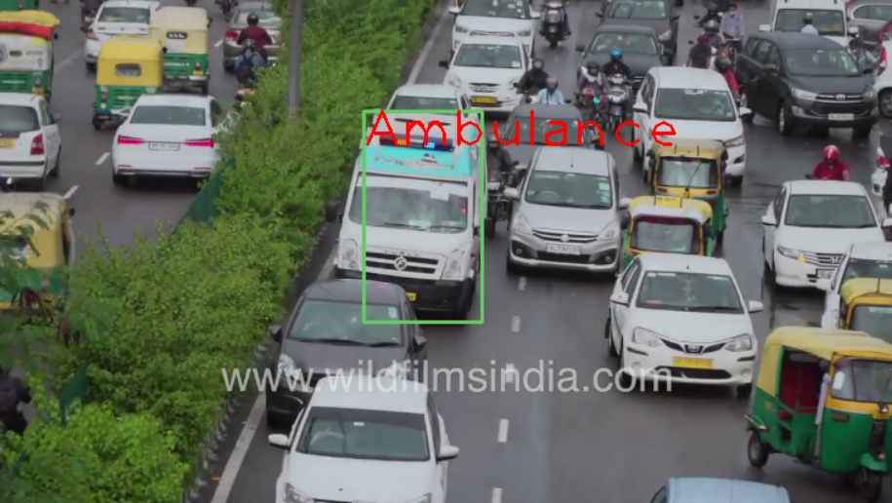
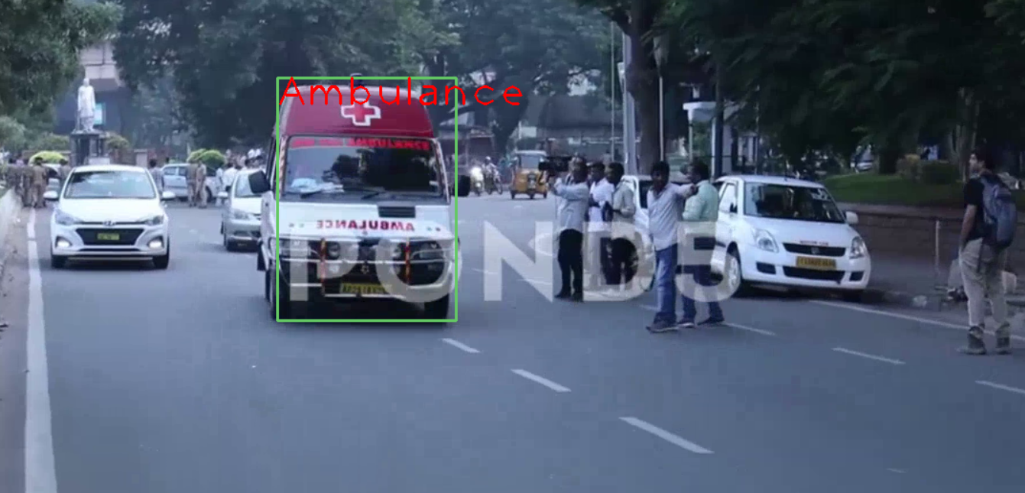
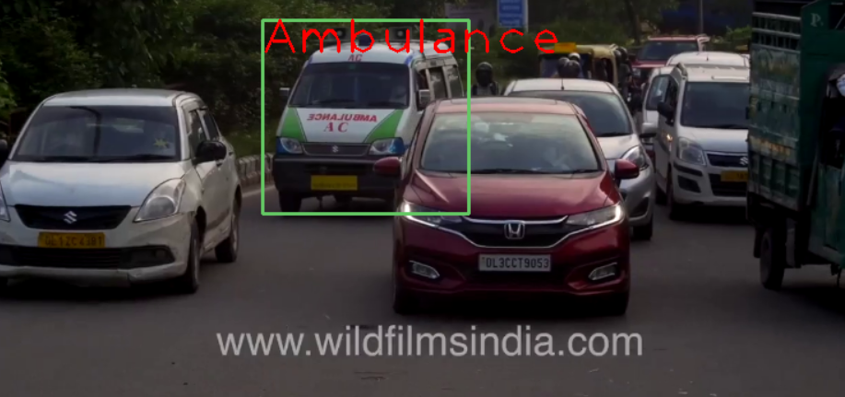
Result
In the End, we able to measure the Traffic density and detect the ambulance in traffic using Image Processing.

Slide 8
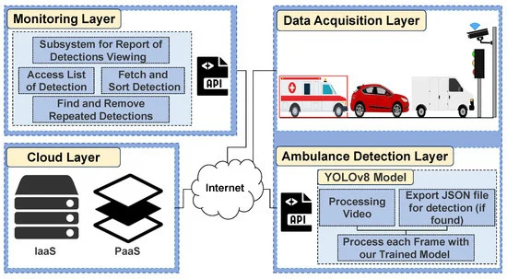
ENHANCE IDEA AND TRAFFIC SIGNAL MANAGEMENT
The Ambulance Detection and Traffic Management System uses AI models like YOLOv3 to identify ambulances through cameras and automatically switch traffic lights to green, ensuring smooth passage for emergency vehicles. This IoT-enabled system enhances emergency response times by prioritizing ambulance movement while managing other traffic efficiently.

Slide 9
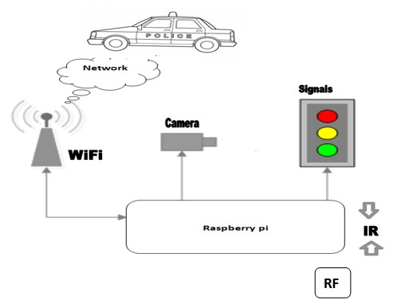
IMPROVEMENT OPPORTUNITY
To identify ambulances through cameras and automatically switch traffic lights to green, ensuring smooth passage for emergency vehicles. This IoT-enabled system enhances emergency response times by prioritizing ambulance movement while managing other traffic efficiently.

Slide 10
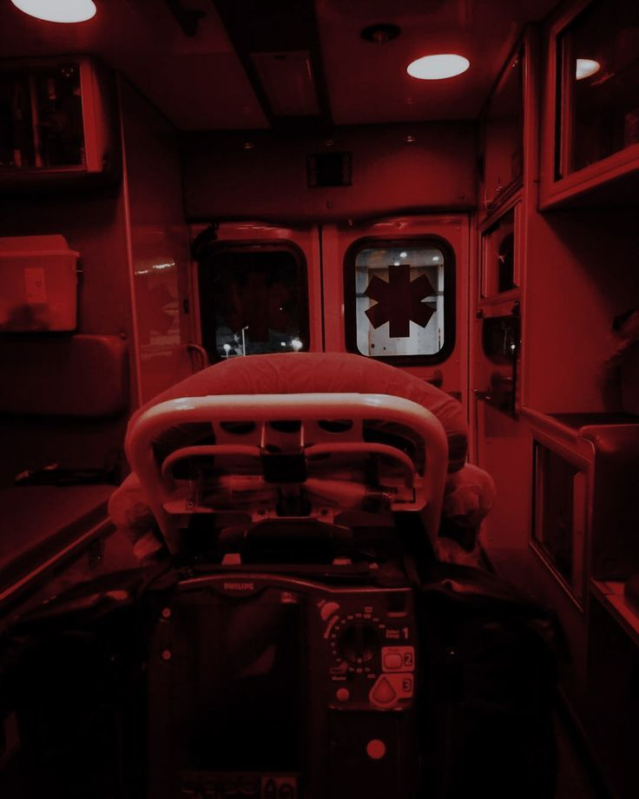

THANK YOU
DONE BY : S.Ranganathan & S.Krishna Babu

